Slide 1

WELCOME TO ENGLISH CLASS

Slide 2
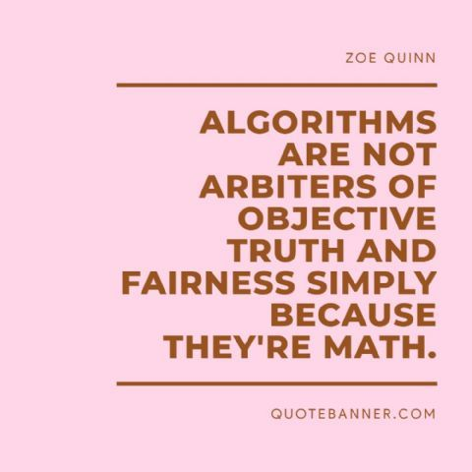
WELCOME TO ENGLISH CLASS

Slide 3
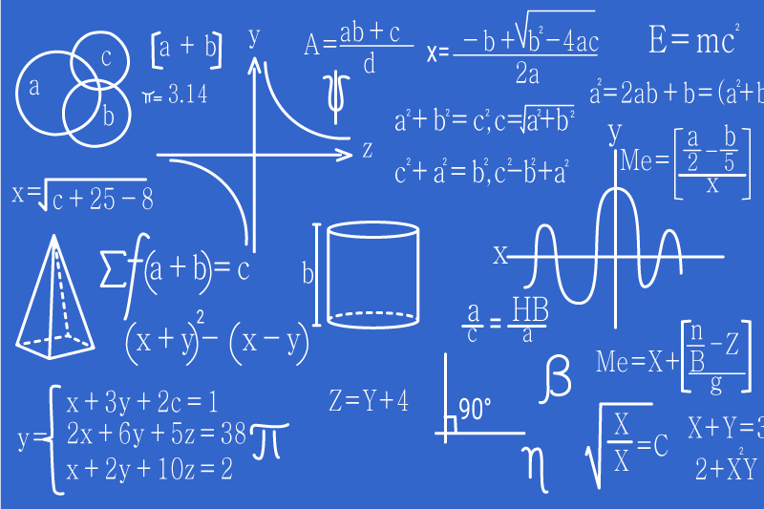
ALGORITHMS

Slide 4

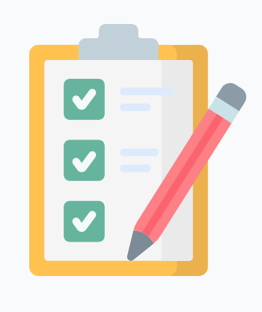

DATE
DATE
Objective:
Students will demonstrate their understanding of the topic Algorithms with a graphic organizer.

Slide 5

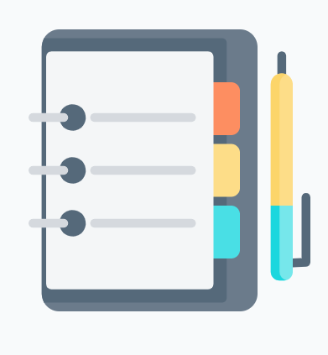


AGENDA
WARM UP:
Find Max
CLASS ACTIVITY:
Let´s practice the class vocabulary
Complete the sentences with the correct option
Reading stragety (video) : Previewing and predicting
Read the Text “What makes a good algorithm?”
Wrap- Up
Complete this multiple-choice exercise to check their understanding of the text.

Slide 6

WARM-UP
“Find Max”
Choose the largest number from the list.
Example:
Set 1
five thousand
seven hundred and twenty-seven
three million
eighty-eight point seven
twelve thousand four hundred and seventeen
The correct answer in Set 1 is “three million”.

Slide 7
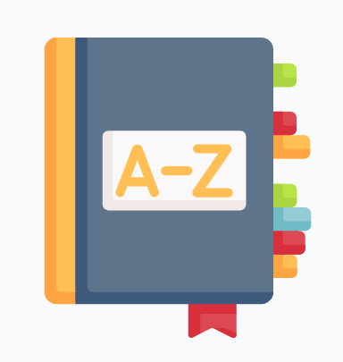
VOCABULARY
Steps
Perform
Recipe
Unambiguous
Set of inputs
Set of outputs
Useful
- Return

Slide 8
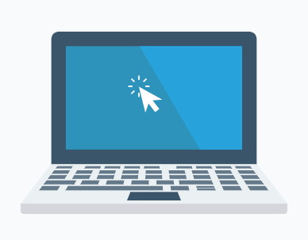
Select the correct option to complete the sentences with the new words.
Today, a cellphone can perform/return many functions of a computer.
English is a very unambiguous/useful language because there is a lot of information in English.
A set of inputs/outputs is the result of an algorithm.
I don´t know how to cook ajiaco, so I need to look for a recipe/output.
This program returns/performs an error message. I need to find the error and correct it.

Slide 9
Video Reading Strategy
https://www.youtube.com/watch?v=5g3dY0SfmtI

Slide 10

Algorithm VS Recipe
An algorithm specifies a series of steps that perform a particular computation. Algorithms are similar to recipes. Recipes tell you how to cook food by completing a number of steps. For example, to make a cake the steps are:
1. preheat the oven;
2. mix flour, sugar, and eggs;
3. pour into a baking pan;
4. etc.
But “algorithm” is a technical term and it is more specific than “recipe”.

Slide 11
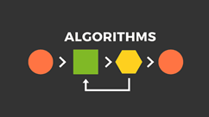
Characteristics of an algorithm
If you call something “an algorithm”, it means that these characteristics are all true:
1. An algorithm is an unambiguous description that makes clear what to implement. In a computational algorithm, a step such as “Select a large number” is not clear: what is “large”? 1 million, 1 billion, or 100?
2. An algorithm expects a defined set of inputs.
3. An algorithm produces a defined set of outputs.
4. An algorithm is guaranteed to terminate and produce a result. If an algorithm could potentially be eternal and run forever, it wouldn’t be very useful because you might never get a result.
5. The majority of algorithms are guaranteed to produce the correct result.

Slide 12
An Example Algorithm find_max()
Problem: From a list of positive numbers, return the largest number on the list.
Inputs: A list L of positive numbers. This list must contain at least one number.
Outputs: A number n, which will be the largest number of the list.
Algorithm:
Set max to 0.
For each number x in the list L, compare it to max. If x is larger, set max to x.
max is now set to the largest number in the list.

Slide 13
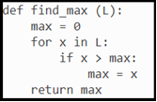
An implementation in Python:
Does this meet the criteria for being an algorithm?
1. Is it unambiguous? Yes. Each step of the algorithm consists of primitive operations, and translating each step into Python code is very easy.
2. Does it have defined inputs and outputs? Yes.
3. Is it guaranteed to terminate? Yes. The list L is not infinite, so after looking at every element of the list the algorithm will stop.
4. Does it produce the correct result? Yes.
Adapted from: https://fiftyexamples.readthedocs.io/en/latest/algorithms.html

Slide 14
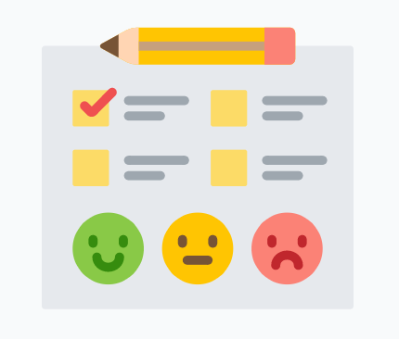
WRAP-UP
Complete this multiple-choice exercise:
The objective of an algorithm is to:
Perform a computation
Perform a recipe
… is more specific.
Recipe
Algorithm
The instruction “Select a large number” is:
Ambiguous
Unambiguous
An eternal algorithm is:
Useful
Useless
The objective of “find_max” is:
To find many numbers
To find the largest number

Slide 15
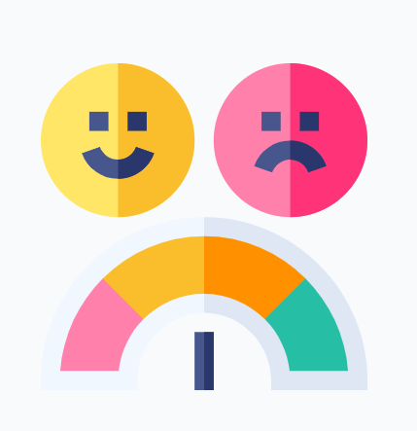
SELF-EVALUATION
1. Entiendo cómo utilizar la estrategia de previsualizar y predecir con un texto.
Yes No Maybe
La estrategia de previsualizar y predecir me ayuda a tener una idea general de qué se va a tratar el texto.
Yes No Maybe
La estrategia de previsualizar y predecir me ayuda a concentrarme más mientras leo.
Yes No Maybe
4. Cuando previsualicé y predije el texto de esta clase, pude adivinar unos detalles correctamente.
Yes No Maybe

